Slide 1
Career Knowledge - Reddit
GraphRAG-Powered Career Advice from Reddit
Unstructured Data · Final Group Project
Jenn · Leslieane · Harelle · David · Aryan

Slide 2
Project Overview
Harelle
Overall Problem
Our team discussed careers going forward, and we noticed that people turn to Reddit for peer advice, but a lot of opinions are buried in unstructured text. With that in mind, we built a four-phase pipeline that scrapes, structures, graphs, and queries real career advice using knowledge graphs.
Phase 1
Phase 2
Phase 3
Phase 4
Data Collection
LLM Extraction
Knowledge Graph
GraphRAG Q&A
Scrape Reddit posts from 5 career subreddits with filtering & pagination
GPT-4o-mini extracts structured JSON: data on roles, outcomes, sentiment
NetworkX graph with almost 11k nodes and roughly 12.5k edges + semantic embeddings
Cosine similarity retrieval + graph traversal

Slide 3
Phase 1 - Data Collection
David
Subreddits Scraped
Data Collection Strategy
r/cscareerquestions
Approach evolution: API → JSON endpoint → local execution
r/careerguidance
Filtered by keywords and score >= 10
r/financialindependence
Flagged posts containing UPDATE or EDIT language
r/ITCareerQuestions
1,080 posts collected and 392 with outcome flags
r/learnprogramming
Career keywords used as filters:
switch, transition, burnout, laid off, salary, offer, interview…

Slide 4
Phase 2 - LLM Extraction Pipeline
David
Model & Config
Extracted Fields (per post)
Model
gpt-4o-mini
problem_type
career_switch, burnout, layoff
Input
reddit_posts.csv
current_role / target_role
data analyst to software engineer
Output
extracted_posts_clean.json
years_experience
integer
Checkpointing
Every 50 posts
constraints
no CS degree, can't relocate
Est. cost
$0.00014 per post
advice_summary
1–2 sentence synthesis
Posts processed
1,897 records
outcome + sentiment
positive / negative
Outcome posts
467 with real outcomes
has_outcome
boolean
salary_mentioned / location
string

Slide 5
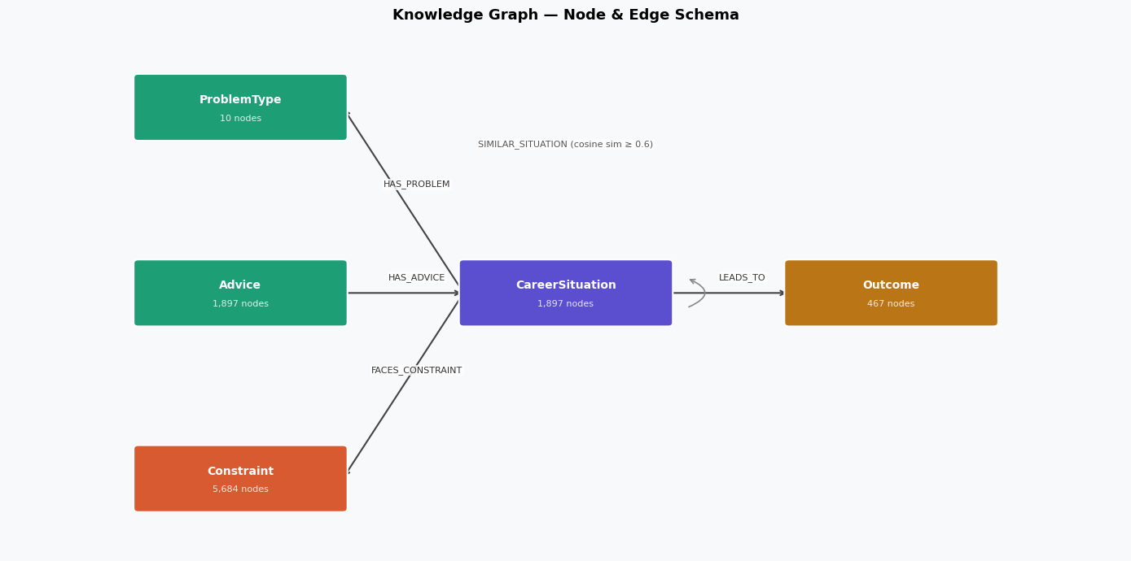
Phase 3 - Knowledge Graph Construction
Leslieane
10,946 nodes | 12,421 edges
Node types:
CareerSituation (1,897): one per Reddit post
Advice (1,897): what people were told
Constraint (5,684): challenges people mentioned
Outcome (467): posts where OP shared what actually happened
Role (991) + ProblemType (10)
Edges connect situations to their advice, constraints, outcomes, and similar posts via OpenAI embeddings

Slide 6
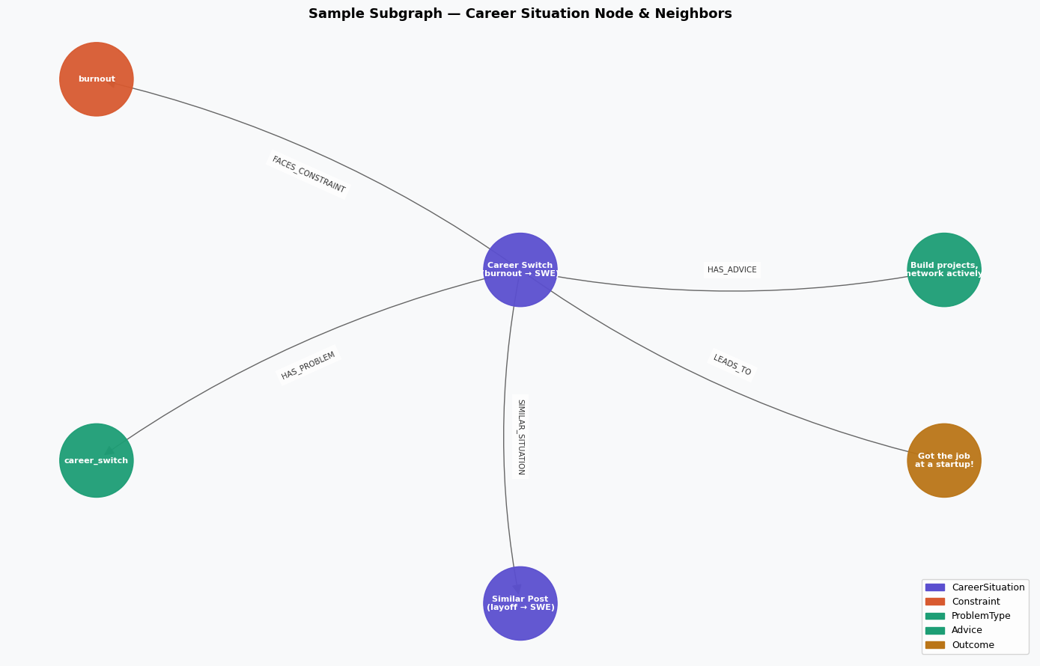
Phase 3 - Knowledge Graph Findings
Leslieane
What the graph showed:
Burnout is the #1 constraint pulling people toward career changes
64.9% of reported outcomes were positive
Job searching (462 posts) dominates over actually switching careers (288)
But worth noting:
Reporting Bias: the 64.9% is likely inflated. People are way more likely to post "I got the job!" than "still unemployed."
Isolated nodes: viral posts got no similar neighbors, graph works best for personal situation
Future fix: filter out viral/news posts before the similarity step

Slide 7
Phase 4 - GraphRAG QA Pipeline
Jenn
Pipeline Architecture
User Input
User describes career situation to query patterns from real Reddit experiences
Embed Query
Converts user’s situation into a vector to match meaning
Find Similar Nodes
Retrieve past CareerSituation nodes that represent similar real world scenarios
Traverse Graph
Pull linked advice, constraints, problems, and outcomes from those situations
Build Grounded Prompt Design
Structure the retrieved evidence into a constraint-aware, data only prompt
Generate Answer (LLM)
Synthesize patterns across real cases into actional, evidence-based career guidance

Slide 8
GraphRAG in Action - Example Queries
Jenn
JOB SEARCH EXAMPLE
What People Did: Focused on improving skills, considered pivoting careers, Sought advice during job search struggles
What Worked/Didn’t: Networking and mentorship, pivoting without preparation, passive frustration with market conditions
Key Constraints: market conditions, further education
Actionable Advice: Strengthen skills, stay proactive, and manage job search strategically despite market challenges
Query
Graph Context Retrieved
Synthesized Answer
“ I’m looking for a software engineering job”
Matched problem type: job_search
Common constraints: laid_off, wants_to_grow_expertise_actively, varied_interview_requirements
Advice node: focused on skill-building and career navigation
Outcomes: sparse / limited
Similar Situations (0.58 - 0.54)
Advice for aspiring SWE
Leveling up as a SWE
Burnout & loss of motivation
CAREER SWITCH EXAMPLE
Query
Matched problem type: career_switch
Constraints: not_enough_experience, lack_of_work_life_balance
Advice node: show lateral-pivot patterns across roles
Outcomes: sparse / limited
What People Did: Pivoted into more specialized or strategic roles, sought stability and better work-life balance
What Worked/Didn’t: Leveraging transferable skills, networking & researching target roles; no specialization in skillset
Key constraints: Lack of direct experience, burnout and fear of being stuck
Actionable Advice: Identify transferable skills, build relevant experience, expect short term trade offs when switching fields
Graph Context Retrieved
Synthesized Answer
“I want to switch from manufacturing to marketing”
Similar Situations (0.55 - 0.46)
Different educational background
Switching industries entirely
Burnout & loss of motivation

Slide 9
Results & Key Contributions
Aryan
Data Pipeline
Career Knowledge Graph
Raw Reddit text to structured graph in 4 automated phases. 1,897 posts processed with LLM extraction
10,946-node graph capturing roles, problems, constraints, advice, and outcomes with typed edges enabling structured traversal.
Semantic Similarity Layer
Grounded GraphRAG Q&A
We used embedding-based SIMILAR_SITUATION edges connect semantically related career posts beyond keyword overlap using 1,536-dim vectors.
The system explicitly refuses to hallucinate when data is insufficient, ensuring trustworthiness.

Slide 10
Conclusion
We demonstrated that unstructured Reddit data can be transformed into a queryable career knowledge graph that delivers evidence-grounded advice
Future Work
Expand to more subreddits & industries beyond tech
Track how advice quality evolves over time
Fine-tune smaller model on graph-grounded career Q&A pairs
Thank you!

Slide 11
Sources
Data Sources:
Reddit (r/cscareerquestions, r/careerguidance, r/financialindependence, r/ITCareerQuestions, r/learnprogramming) — scraped via Reddit JSON API, 1,897 posts
Tools & Models:
OpenAI GPT-4o-mini — LLM extraction + answer synthesis
OpenAI text-embedding-3-small — semantic embeddings
NetworkX — graph construction
Claude (Anthropic) — coding assistance
References:
Edge et al. (2024) — GraphRAG paper - arxiv.org/abs/2404.16130

